Slide 1
Social Entrepreneurship, a tool for Sustainable Development
Victor Fabunmi
SRADeV Nigeria

Slide 2
‘Social entrepreneurs are not content just to give a fish or teach how to fish. They will not rest until they have revolutionized the entire fishing industry’.
Bill Drayton

Slide 3
Entrepreneurship/ Entrepreneur:
According to Jean-Baptiste Say
Shifts of economic resources out of an area of lower into higher productivity and greater yield.
-French concept of value creation.
Schumpeter- the entrepreneur as an agent of change within the larger economy. Innovational/ Revolutionary
Peter Drucker- as canny and committed exploiter of change within the economy. According to Drucker, “the entrepreneur always searches for change, responds to it, and exploits it as an opportunity.” Adaptive
What is entrepreneurship?
Who is an entrepreneur:

Slide 4
Qualities of an entrepreneur
Creative thinker- finds a wholly new way of approaching the problem
Acts directly
Courage - This often requires entrepreneurs to take big risks and do things that others think are unwise, or even undoable
Fortitude to drive their creative solutions through to fruition and market adoption

Slide 5


Slide 6
What is Social Entrepreneurship (SE)?
It is a concept that merges these 3 components
identifying a stable but inherently unjust equilibrium - causes the exclusion, marginalization, or suffering of a segment of humanity that lacks the financial means or political clout to achieve any transformative benefit on its own;
identifying an opportunity in this unjust equilibrium, developing a social value proposition, and bringing to bear inspiration, creativity, direct action, courage, and fortitude, thereby challenging the stable state’s hegemony;
forging a new, stable equilibrium that releases trapped potential or alleviates the suffering of the targeted group, and through imitation and the creation of a stable ecosystem around the new equilibrium ensuring a better future for the targeted group and even society at large.

Slide 7
Who is a social entrepreneur?
The social entrepreneur is a mission-driven individual who uses a set of entrepreneurial behaviours to deliver a social value to the less privileged, all through an entrepreneurially oriented entity that is financially independent, self-sufficient, or sustainable.

Slide 8
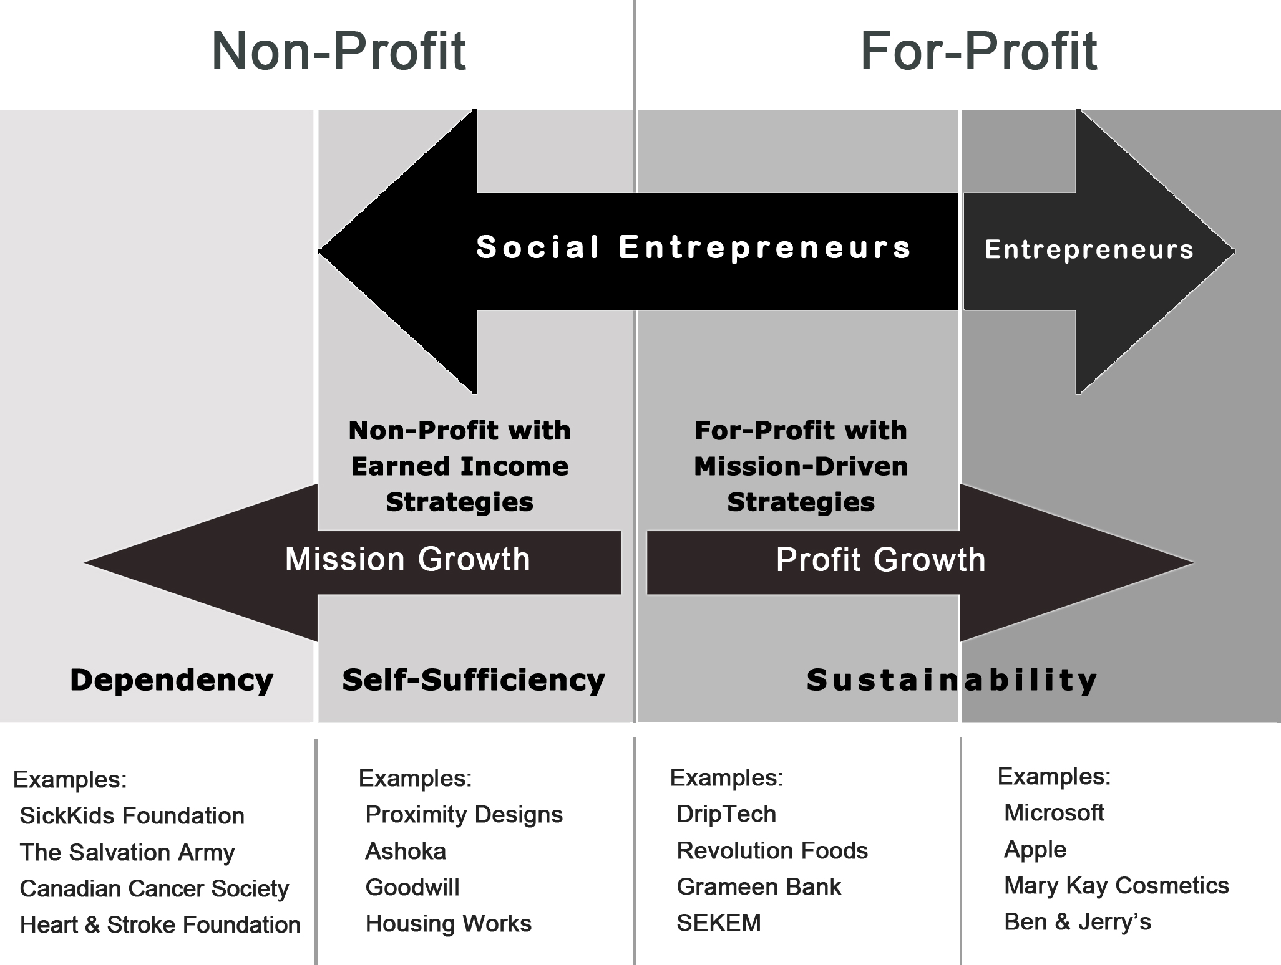
Boundaries of SE
The entrepreneurship spectrum illustrating the boundaries of social entrepreneurship

Slide 9
Difference between business and social entrepreneurship
The differences lie in their actions and motives.
Social entrepreneurs concentrate more on transforming the approaches of modern society for the good of the community and the environment, whilst business entrepreneurs concentrate a lot more on the income and wealth-building aspect of things.
S/N | Business entrepreneurship | Social entrepreneurship
1. | It is individual | It is collective
2. | Its seeks to satisfy customer needs and expand business potentials | It respects the vulnerable so as promote their quality of life
3 | Its success is measured by its profit | Success is measured by its social impact
4 | Its focus is the market | Focuses on solution to social problems

Slide 10
Examples of social entrepreneur
Muhammad Yunus, founder of the Grameen Bank and father of microcredit, provides a classic example of social entrepreneurship.
Victoria Hale a pharmacist, created the Institute for OneWorld Health.
NB: social entrepreneurship is distinct from social service.

Slide 11
Examples of Environmental based SE models
Teju Ravilochan founded Unreasonable Institute aimed at solving the world’s different problems like poverty, access to clean water. They have put up an institute that has currently helped 148 startups.
At 24 years old, Tsechu Dolma has helped her native Tibet in addressing poverty and food insecurity issues common in the mountain communities of her country, helping them confront the challenges by climate change.
MyShelter Foundation and Liter of Light were founded by model-turned-social entrepreneur Illac Diaz from the Philippines. Liter of Light, in particular, has successfully provided light to communities with no access to electricity with just the use of recycled softdrinks and water bottles. The Foundation has now expanded to more than 12 countries. Diaz recognized as one of Asia’s Game Changers for 2014.
Up Top Acres has turned rooftops in Washington DC into urban farms that has since produced 60,000 pounds of food delivered to restaurants and other members of the community.

Slide 12
Some Nigerian environmental SE models
Bilikiss Adebiyi-Abiola is a Nigerian entrepreneur and innovator, and founder and CEO of WeCyclers. This Lagos-based company is focused on giving low-income communities in developing countries a chance to capture value from waste and clean up their neighborhoods through an incentive-based recycling program.
Nigerian story – RESWAYE – Coastal Clean-up, Doyin Ogunye
Achenyo Idachaba is a Nigerian social entrepreneur with a passion for finding solutions to an ecological problem adversely affecting local communities. E.g. making artefacts from water hyacinths.

Slide 13
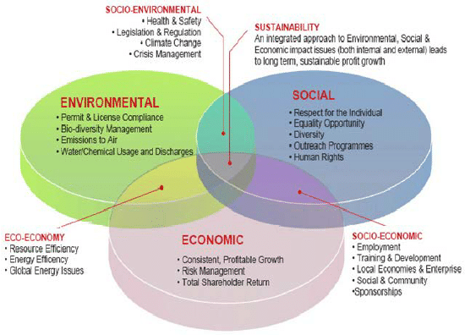
Sustainable Development (SD)
Brundtland Commission, defined SD as the development that “meets the needs of the present without compromising the ability of future generations to meet their own needs”.
The strategy was proposed by the European Commission for the EU Member States is the Lisbon Agenda for growth and jobs.
Elements of SD

Slide 14
The role of SE in SD
Social entrepreneurship involves the mobilization of every resource available in the community in order to remove social problems through using innovative plans and effective communication.
This effort disturbs trade standards governing the business environment and removes existing barriers to achieve economic and social sustainable development.
Social Entrepreneurship
Social Responsibility
Social Innovation
Social Value
Culture
Sustainable Environment
Sustainable Social Economy
Sustainable Society
Sustainable Development
Framework of the relationship between Social Entrepreneur and Sustainable Development (Forouharfar and Salarzehi, 2019)

Slide 15
Importance of SE to the SDGs
15 Award-Winning Entrepreneurs Share their Insights
SEs offer financially self-sustaining models for positive social change
The key word in the Sustainable Development Goals, is SUSTAINABLE. Without social enterprises, development to achieve these goals will not be sustainable.
SE affords the resources to scale solutions for massive impact no other entity
The SDGs aren’t achievable without wide buy-in from all, just as sustainability isn’t possible without inclusiveness. Social enterprise, because it’s engrained with sense of responsibility to community, promotes this inclusiveness

Slide 16
Importance of SE to the SDGs Cont’d
Social enterprises allow society to react with smart, market-oriented solutions to global problems that can no longer be solved by governments. It brings stakeholders together to think and build return on impact in a viable way.
The depth of the issues that the Sustainable Development Goals are seeking to achieve need the most catalytic and innovative engagements, these are represented by the determination and vision of social enterprises.
Social enterprises are critical to achieving the Sustainable Development Goals because collectively they represent a new generation of energized leaders, focused on change at scale.
Social Enterprise balances sustainability and impact, paving the way to realize a long-term vision with measurable short-term steps.
Having a concrete and well-defined social impact goal rather than enterprise-based commercial intent is a strong driver to add much more value to what you try to achieve

Slide 17
Conclusion
“Whenever society is stuck or has an opportunity to seize a new opportunity, it needs an entrepreneur to see the opportunity and then to turn that vision into a realistic idea and then a reality and then, indeed, the new pattern all across society. We need such entrepreneurial leadership at least as much in education and human rights as we do in communications and hotels. This is the work of social entrepreneurs.”
Bill Drayton
Founder of Ashoka: Innovators for the Public

Slide 18
Recommendations
There is need for awareness creation of this concept among relevant stakeholders.
The government should empower individuals with interest of making social impact.
Corporate bodies should encourage the concept through hinging social responsibilities around it.
International donors should empower civil societies to look beyond social servicing but also incorporate social entrepreneurship into their operation towards sustainability.

Slide 19
References
Forouharfar A., Rowshan S. R., and Salarzehi H. (2019). The Relationship between Social Entrepreneurship and Sustainable Development from the Social Experts’ Points of View Article · September 2019 DOI: 10.30473/EE.2019.6059
https://www.google.com/url?sa=i&url=https%3A%2F%2Fironline.american.edu%2Fblog%2Fsocial-entrepreneurship-degree%2F&psig=AOvVaw0s7A5boftWnWjy2wEIpY__&ust=1604264765886000&source=images&cd=vfe&ved=0CAIQjRxqFwoTCIjYhY7e3-wCFQAAAAAdAAAAABAU
https://www.researchgate.net/figure/Differences-between-business-entrepreneurship-and-social-entrepreneurship_tbl1_257200841
Jean-Baptiste Say, quoted in J. Gregory Dees, “The Meaning of ‘Social Entrepreneurship,’” reformatted and revised, May 30, 2001.
Joseph A. Schumpeter, Capitalism, Socialism, and Democracy (New York: Harper, 1975): 82-85.
Lubberink R. (2019) Social Entrepreneurship and Sustainable Development. In: Leal Filho W., Azul A., Brandli L., Özuyar P., Wall T. (eds) Decent Work and Economic Growth. Encyclopedia of the UN Sustainable Development Goals. Springer, Cham. https://link.springer.com/referenceworkentry/10.1007/978-3-319-71058-7_47-1
Peter F. Drucker, Innovation & Entrepreneurship (New York: Harper Business, 1995): 28.
https://www.google.com/search?q=images+of+social+entrepreneurship&sxsrf=ALeKk01MKb_sDsrmuyDgNgYp643xumow9w:1608280962572&source=lnms&tbm=isch&sa=X&ved=2ahUKEwjThOS7kdftAhXiSRUIHaeuBv4Q_AUoAXoECBAQAw&biw=1075&bih=647#imgrc=upZpfcnNtOmvzM
https://en.wikipedia.org/wiki/Ashoka_(non-profit_organization)
https://proximitydesigns.org/
https://medium.com/do-contribute/how-social-entrepreneurs-can-help-the-environment-c321e0d3ef6e

Slide 20
Thanks for listening

