Slide 1
The Role of Technology In Environmental Management
Presented by: Bello Oluwaseun

Slide 2
Outline
What is Technology?
Environmental Management
Technology and Environmental Management(Good)
Green Technology
Technology and Environmental Management(Bad)
Technology Transfer
Future Prospects
Conclusion
Recommendation

Slide 3
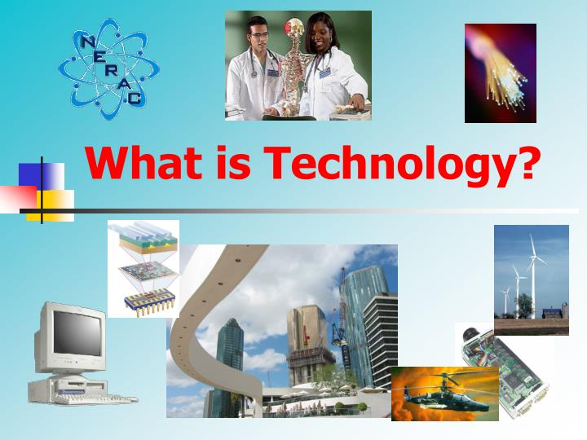
What Is Technology?

Slide 4

Technology is the theoretical and practical knowledge, skills, and artifacts that can be used to develop products and services as well as their production and delivery systems. (Burgelman et.al,1996)
Technology is obtaining certain result, resolving certain problems, completing certain tasks using particular skills, employing knowledge and exploiting assets (Lan and Yung, 1996)
Technology is a cultural system concerned with the relationships between humans and their environment (Tepstra and David,1985).

Slide 5
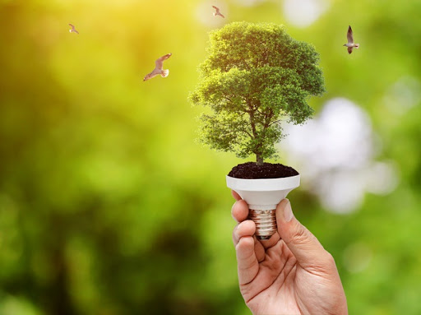
Environmental Management
Environmental management is a ‘purposeful activity with the goal to maintain and improve the state of an environmental resource affected by human activities.
Environmental management is the management of the interaction and impact of human activities on the natural environment.
The aim of environmental management is to ensure that ecosystem services and biodiversity are protected and maintained for equitable use by future human generations.

Slide 6
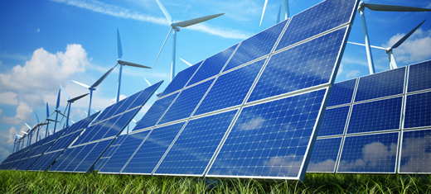
The pressure for sustainable environment has emerged in companies and the incorporation of technologies as part of the manufacture of products.
However, incorporating technologies into manufacturing does not always represent a reduction of the environmental burden.

Slide 7
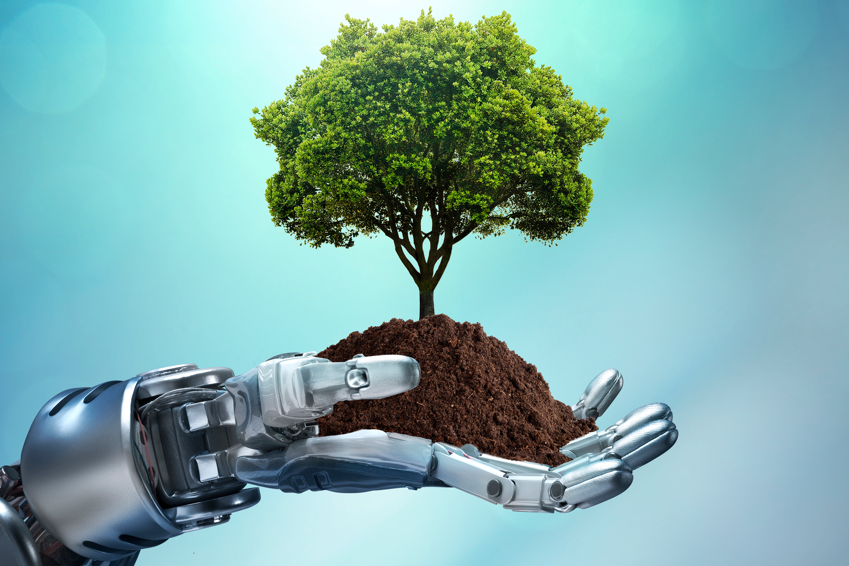
Technology and Environmental Management(Good)
Technology has positively impacted the environment in so many ways, that life without technology seems impossible. Such ways are:
Renewable energy: Modern environmental technology has enabled us to capture naturally occurring energy and convert it into electricity or useful heat through devices such as solar panels, wind and water turbines.
Smart Technology: For example, intelligent lighting systems only illuminate areas that require it and a smart thermostat keeps homes at certain temperatures during certain times of day, therefore reducing wastage.

Slide 8
Electric Vehicles: demonstrate a positive impact of technology on the environment because they do not produce carbon emissions, which contribute towards the ‘greenhouse effect’ and leads to global warming. Furthermore, they do not contribute to air pollution, meaning they are cleaner and less harmful to human health, animals, plants, and water.
Advanced Ceramics: components ensure long life for parts that are subject to high stress in the field of environmental technology – for instance in water treatment or recycling and processing and recycling of waste
Software Creation: In 2001 a group of undergraduates at Havard created a remote notebook useful to marine biologists and others working in wet environments.
Improved Simulated environments: Using artificial intelligence, weather forecasts and so many other elements can be accurately predicted and natural disasters have been avoided.
Use of Geographical Information System (GIS)
Database collation ad analysis
Environmental Information System
Remote Sensing and Satellite monitoring.

Slide 9
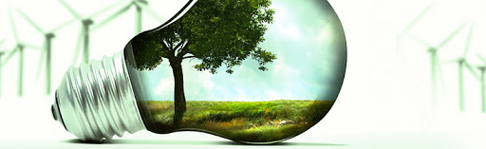
Green Technology
Green Technology refers to a system that uses innovative methods to create environment friendly process, products and services.
Going green or using technologies that are friendly to the environment is among the many ways that countries are looking into in order to spur economic growth and improve the lives of its citizens.
Green technology uses renewable natural resources that never depletes, new and innovative energy generation techniques.

Slide 10
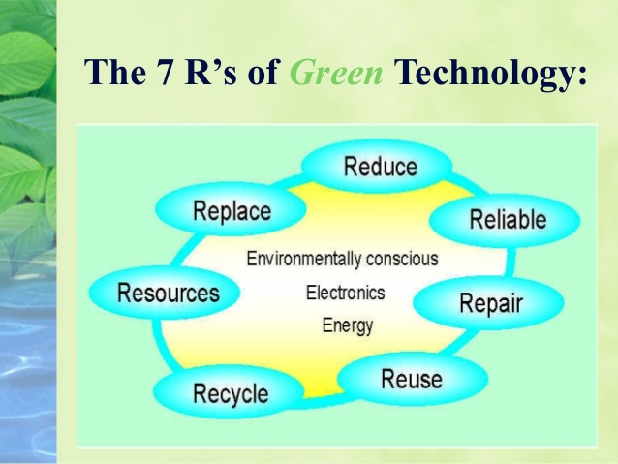
One of the important factors for environmental pollution is the disposal of waste. Green technology has answers to that as well. It can effectively change waste pattern and production in a way that it does not harm the planet and we can go green.
One of the best known examples of green technology would be the solar cell. A solar cell directly converts the solar energy (commonly referred as ‘light’) into electrical energy through the process of photo-voltaics (photo-electric effect). Generating electricity from solar energy means less consumption of fossil fuels, and reduction in the pollution and greenhouse gas emissions

Slide 11
Advantages and Disadvantages of Green Technology
Advantages
Disadvantages
Does not emit anything harmful into the air
Can bring economic benefits to certain areas
Requires less maintenance so one doesn’t have to shell out a lot of money to operate it
Renewable, i.e. it will never run out
Can slow the effects of global warming by reducing CO2 emissions
High costs of implementation
Lesser known alternative chemicals or raw material inputs
Lesser known alternative process technologies
Uncertainty about performance impacts
Lack of human resources and skills

Slide 12
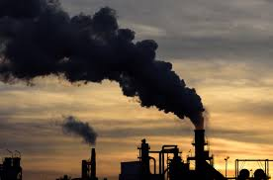
Technology and Environmental Management(Bad)
The impact of technology on the environment has included the misuse and damage of our natural earth. These technologies have damaged our world in two main ways; pollution and the depletion of natural resources.
Air pollution: The main sources all relate to technologies which emerged following the industrial revolution such as the burning of fossil fuels, factories, power stations, mass agriculture and vehicles. The consequences of air pollution include negative health impacts for humans and animals and global warming.

Slide 13
Water pollution: is the contamination of water bodies such as lakes, rivers, oceans, and groundwater, usually due to human activities. Some of the most common water pollutants are domestic waste, plastics, industrial effluents and insecticides and pesticides. A specific example is the release of inadequately treated wastewater into natural water bodies, which can lead to degradation of aquatic ecosystems
Depletion of Natural Resources: Resource depletion is another negative impact of technology on the environment. It refers to the consumption of a resource faster than it can be replenished. Natural resources consist of those that are in existence without humans having created them and they can be either renewable or non-renewable. There are several types of resource depletion, with the most severe being aquifer depletion, deforestation, mining for fossil fuels and minerals, contamination of resources, soil erosion and overconsumption of resources

Slide 14
Technology Transfer
Technology transfer is often a chaotic, disorderly process involving groups and individuals who may hold different views about the value and potential use of the technology (Gibson and Smilor, 1991). Researchers, developers and users are likely to have different perceptions about technology.
This is a major issue between Technology and Environment. Sustainability of technology and methods used to curb environmental degradation is important. Researchers, companies and academics should be guided by lay down environmental friendly modes of technology application.

Slide 15

Future
The future of technology in environmental management is highly dependent on policies, sanctions and global awareness. If properly used technology will cause positive environmental development.
One major future stride is the use of satellites and machine learning to detect plastic in the ocean. It is essential to identify which parts of the ocean collect the most plastic to effectively target cleanup and pollution prevention efforts.
The Near Infrared(NIR) signals of various floating objects vary. Using the satellite data, researchers trained a machine-learning algorithm to identify the light signal of floating plastic by releasing a plastic float off the coast of Greece and obtaining the associated light signal data from the satellites.

Slide 16
Conclusion
According to a research done by MOORI,SHIBAO & SANTOS (2018), there is evidence that technologies provide tangible advantages to environmental management, although several of them could only be achieved in the long term.
Having an integrated managerial vision between company and environment; and of practical nature in which new ways of designing products can reduce environmental degradation.
Transfer of green technology should be made easier through government policies and actions.

Slide 17
Recommendation
Data from exercises such as brand audit, can be used by companies and relevant agencies to form a database and an action plan, that can be used to regulate companies.
More research into green technologies and alternative chemicals, this can be fostered by introduction of incentives and grants to such programs by the government, Ngo’s and companies.

Slide 18

THANK YOU

