Slide 1
Green Capitalism; A tool for sustainable development
Prepared by Azeez Yusuf
Project support officer
SRADeV Nigeria

Slide 2
Content
Definitions of Capitalism
Capitalism and Its Impact on environment
Green Capitalism Defined Success stories
Arguments for and against Green Capitalism
Green Capitalism and Sustainable Development
Conclusions and Recommendations
Notes:
Insert a map of your country.

Slide 3
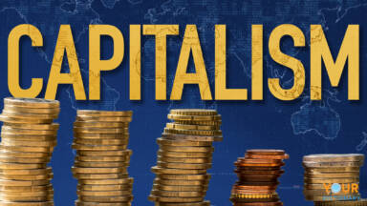
Definitions of Capitalism
Capitalism is an economic system characterized by private ownership of the means of production, especially in the industrial sector.
In a capitalist market economy, decision-making and investments are determined by every owner of wealth, property or production ability in capital and financial markets whereas prices and the distribution of goods and services are mainly determined by competition in goods and services markets.
Other Characteristics of Capitalism:
  Private ownership of the means of production
  High levels of wage labour.
  The investment of money to make a profit.
  The use of the price mechanism to allocate resources between competing uses.
  Economically efficient use of the factors of production and raw materials due to maximization of value added in the production process.
  Freedom of capitalists to act in their self-interest in managing their business and investments
Notes:
Insert a picture of one of the geographic features of your country.

Slide 4
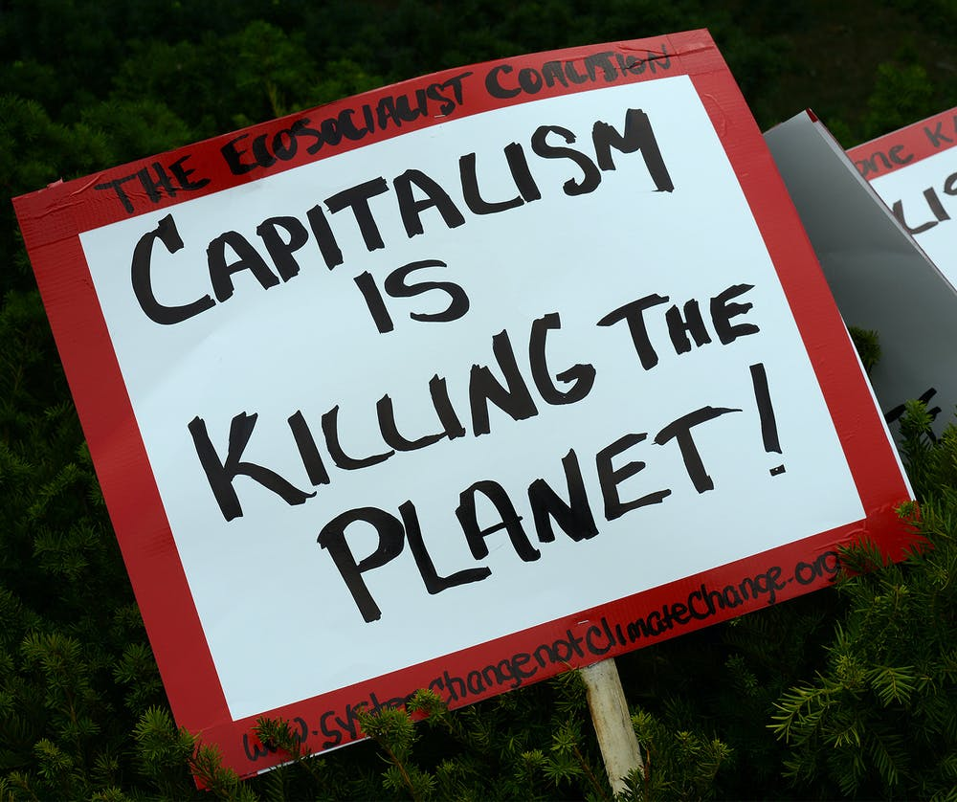
Capitalism and its environmental impact
“Climate change” is the most severe impact capitalism has had on the environment; burning fossil fuels releases carbon dioxide and other greenhouse gases into the atmosphere, heating up the planet and severely altering the climate system. Climate change is the increase in global temperatures above coping capacity of the atmosphere arising from Green House Gases (GHG) emissions– IPCC Assessment 2018.
Also important are pollution of air, water, and soil pollution, soil erosion, ocean acidification, species extinctions
Our bodies are also polluted with a variety of synthetic chemicals as well as metals such as mercury and Lead
UN in 2010 found that the world’s 3,000 largest companies cause around $2.2 trillion (around £1.4 trillion) of environmental damage every year.
Having identified all these adverse impact of capitalism on the environment. Hence, the need for a model that saves the earth as well as allowing for growth in economy bore Green Capitalism (also referred to as Eco-Capitalism, Green Economy.

Slide 5
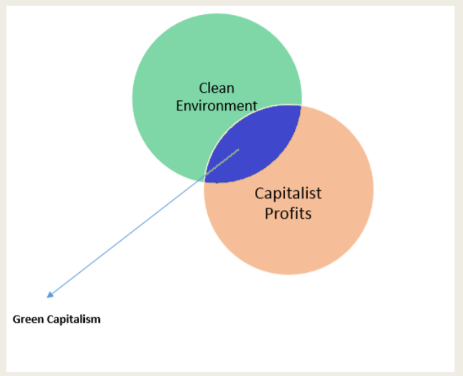
Green Capitalism Defined
Refers to a wide range of modern financial and investment tools that corporations utilize in channeling financial investments into sustainability.
Green capitalism shows that maximizing profit and saving the planet can harmoniously co-exist.
clean environment is converted to a ‘commodity’ that Corporations sell to investors in order to make profits.
Notes:
Insert a picture illustrating a season in your country.

Slide 6
Success stories
The success story of DuPont, the chemical company. In the late 1990s, DuPont voluntarily adopted the goals of the Kyoto Protocol, which meant they would cut their greenhouse gas emissions to less than half of 1991 levels. This led to a net savings of $6 for every ton of carbon dioxide that DuPont shed.
Republic of Korea: National Strategy for Green Growth and Five Year Plan (2009) in 2008, partly in response to the global financial crisis: The Republic of Korea (RoK) adopted ‘low carbon green growth’ as the country’s new development vision, which was followed shortly after by the release in 2009 of their National Strategy for Green Growth and Five‐Year Plan for Green Growth. Their strategy has three objectives: 1. Promote a synergistic relationship between economic growth and environmental protection. 2. Improve people’s quality of life and promote a green revolution in their lifestyles. 3. Contribute to international efforts to fight climate change and other environmental threats.
Notes:
Insert a picture of an animal and or plant found in your country.

Slide 7
Arguments for Green Economy
Green economy potentially works towards decreasing environmental pollution, and thus improves the quality of soil, water and air and also protects environmental well-being.
Global warming, loss of biodiversity, deforestation, desertification, resource depletion can gradually be obstructed by implementing Green economy which will automatically save the earth and its animals from destruction as far as possible.
Economic growth is also enhanced due to the establishment of new markets for biofuels and renewable energy resources.
Establishment of new markets have potential to support international advantages when these new markets will invite funds through exports and also increase domestic sales.
Creation of more industries means more employment and more employment means more stable society as economically, the people will be secured.
Notes:
Add key points in the history of your country to the timeline.

Slide 8
Arguments against Green Economy
Transition to Green economy is time consuming and will require constant vigilance and efforts, though the effort and time engaged in the process have a worthy outcome.
Initially the costs of the goods can be very high because establishment of new green industries and their technologies will involve high expense.
Green and environment friendly products are always more costly than the conventional goods.
Hard Work, constant effort, extra time and more highly educated faculties will be demanded for the creation of and gradual increase in efficiency of new educational disciplines.
New Inventions and discoveries will involve extensive researches which will cost large amount of investment by the government.
Notes:
Insert a picture illustrating a custom or tradition here.

Slide 9
Green Capitalism and Sustainable development.
Green Capitalism fulfils 3 of the SDGs 2015
Goal 11- Sustainable Cities and Communities
  Cities account for between 60 and 80 per cent of energy consumption and generate as much as 70per cent of human-induced greenhouse gas emissions: Make cities inclusive, safe, resilient and sustainable
Goal 12- Responsible Production and Consumption
  is about doing more and better with less. It is also about decoupling economic growth from environmental degradation, increasing resource efficiency and promoting sustainable lifestyles
Goal 13- Climate Action
  Climate change is affecting every country on every continent. It is disrupting national economies and affecting lives. Weather patterns are changing, sea levels are rising, and weather events are becoming more extreme. The Paris Agreement, adopted in 2015
Notes:
Insert a picture of the head leader of your country.

Slide 10
Recommendation and conclusion
Deliberate policy and investment decisions will need to be taken by governments to green their economies
Communications about a green economy should begin to go beyond thinking of it as just conventional green jobs, although the latter will remain, obviously, very important.
Further analytical work on the costs and benefits of various policy instruments and production materials also needs to be carried out to mitigate for the price increase of green products
green growth will be based on a deepened collaboration with other international organisations, including UN agencies, the World Bank and the Global Green Growth Institute, as well as a range of stakeholders, to facilitate the exchange of experience and best practices, and to help promote international arrangements that are conducive to greener growth in both developed and developing countries.
Notes:
Insert a picture that illustrates some part of your country’s economy.

Slide 11
references
“Why capitalism is toxic to the environment by fred Magoff
http://politicsandthat.com/2014/05/13/capitalism-is-destroying-the-planet/
https://www.exeter.ac.uk/media/universityofexeter/research/microsites/exeterenergy/Corporations_and_Sustainable_Energy-_Kikelomo_O_Kila.pdf
https://www.un.org/sustainabledevelopment/
https://www.linkedin.com/pulse/green-economy-advantages-disadvantages-swikriti-sheela-nath/
Notes:
Insert a picture of one of the points of interest for your country.

Slide 12
Thank You

